Slide 1


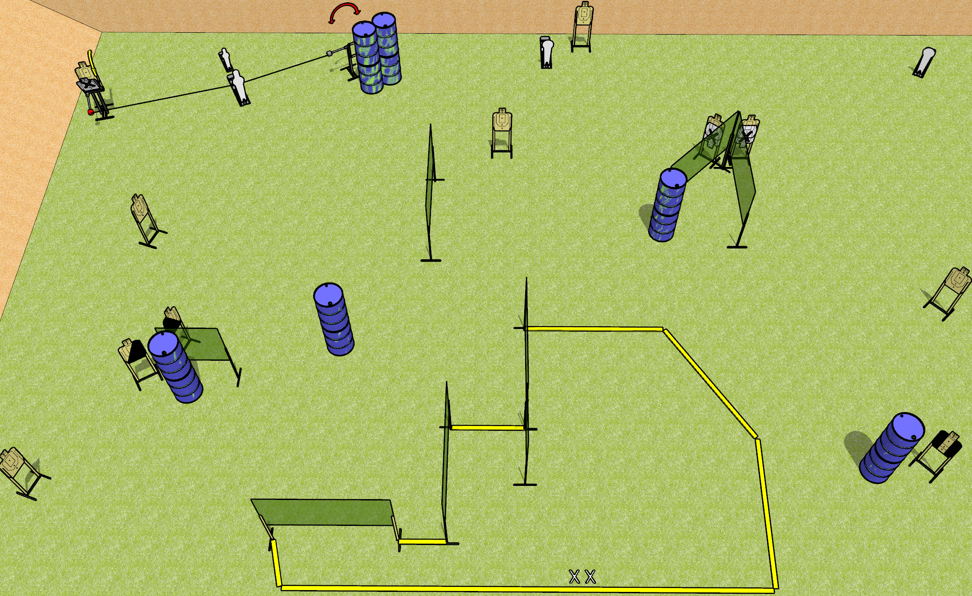
 | Dothan Gun Club – USPSA Match Write That Down Course Designer : Drew Coleman Bay: 10
Round Count 28 rounds 12 USPSA 1 mini, 1 pepper, 2 colts
Equipment List 15 wall feet Swinger, max trap, activators 1 left + 1 right diag, 1 tux 12 targets (9 + 3NS)
10’
10’
5’
4’ wall
10’
3’
3’
30’ back fault line

Slide 2
Write That Down
Written Stage Briefing
Scoring: Comstock Rounds: 28
Targets: 12 USPSA, 4 steel
Handgun start position: feet on X’s, wrists below belt. Handgun is loaded and holstered.
PCC start position: feet on X’s, stock on belt. Loaded carbine is held with both hands, safety on.
Stage Procedure: on the audible start signal, engage targets as they become available from within the shooting area. The max trap and swinger are both activated by the P1 and remain visible at rest.

